Slide 1
Robot End-of-Arm Tooling
IMSE 381:INDUSTRIAL ROBOTS
Lecture 5
IMSE381

Slide 2
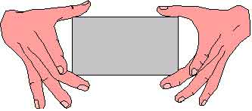
Robot End-of-Arm Tooling
(End Effectors)
End-of-Arm tooling are referred to as End Effectors
End Effector is a device that attaches to the wrist of robot arm and enables the robot to perform a specific task.
Basic Categories
  1. Grippers : used to grasp an object, and hold it during the robot work cycle. Primarily used in materials transfer.
  2. Tools: used when the robot is required to perform an operation on a workpiece; examples: spot welding guns, spray painting tool
IMSE381

Slide 3
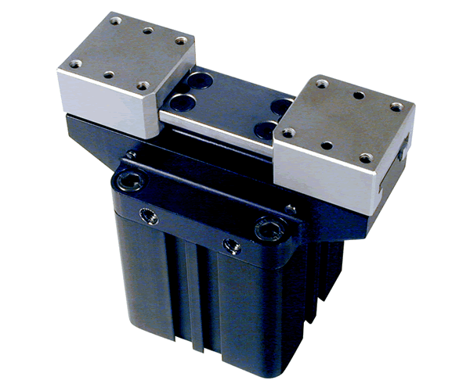
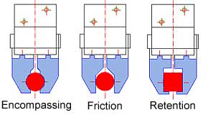
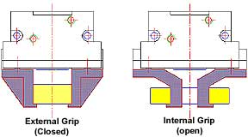
Gripper classification according to the grasping device
Single grippers
  only one grasping device is mounted to the robots wrist.
Double grippers
  two grasping devices attached to the wrist, therefore it can handle two separate objects. The grasping devices can be actuated independently.
External grippers
  the part is grasped on its exterior surface.
Internal grippers
  the part is grasped in its internal surface.
IMSE381

Slide 4
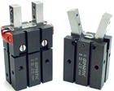
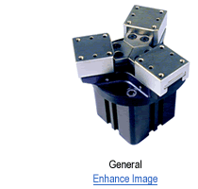

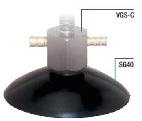
Gripper classification based on the gripping strategy
Mechanical grippers
Vacuum cups
Magnetic grippers
Adhesive grippers
Others such as hooks, scoops, etc.
http://www.youtube.com/watch?v=Yx9axnp6rSM
IMSE381

Slide 5
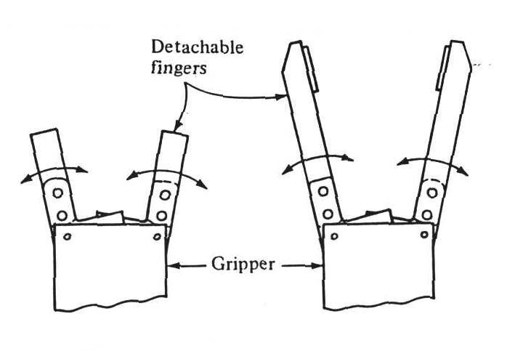
Mechanical Grippers
A mechanical gripper is an end effector that uses mechanical fingers actuated by a mechanism to grasp an object.
The fingers are either attached to the mechanism or are an integral part of the mechanism.
Mechanical Gripper
Dource: Groover
IMSE381

Slide 6
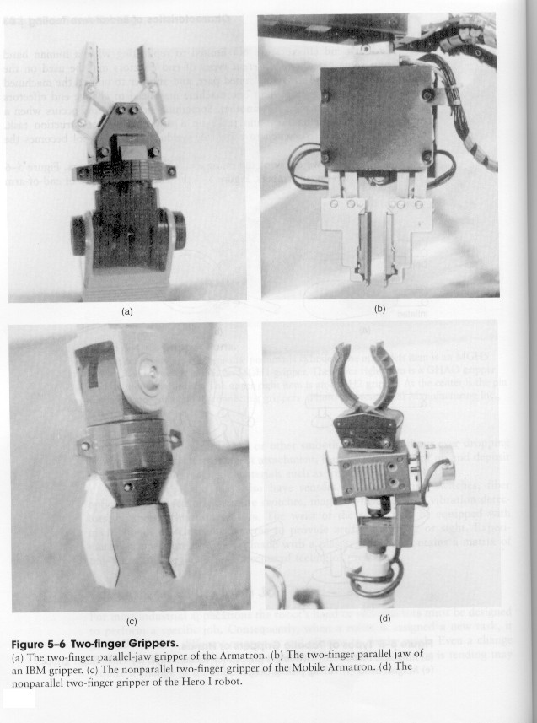
Two Finger Grippers
http://www.youtube.com/watch?v=8Qi15jj_UWQ
IMSE381

Slide 7
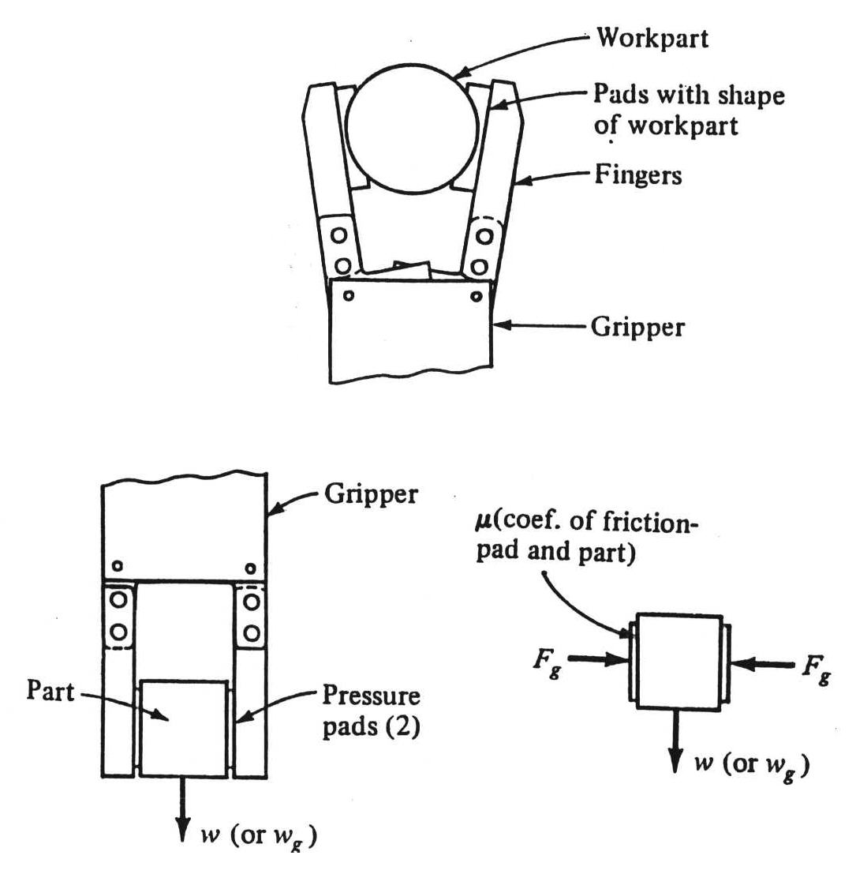
Methods for constraining the part in the gripper
1. Physical constriction of the part within the fingers. Here, the gripper fingers enclose the part in some extent
2. Holding the part by the friction between the fingers and the workpiece
  Here, the fingers must apply a force that is sufficient for friction to retain the part against gravity, acceleration, and any other force.
Physical Constriction of Part
Holding by Friction
IMSE381

Slide 8
Advantages and Disadvantages
Advantages
  The friction method results in a less complicated and therefore less expensive gripper design.
  Adaptable to a greater variety of work parts.
Disadvantages
  If a force of sufficient magnitude is applied against the part in a direction parallel to the friction surfaces of the fingers, the part might slip out of the gripper.
IMSE381

Slide 9
Gripping Force
The gripper must be designed to exert a force to hold the part and prevent it from slipping out of its fingers.
The gripping force is function of the weight of the part, the coefficient of friction between the part surface and the finger surface, acceleration (deceleration) of the part, and the orientation between the direction of motion during acceleration and the direction of the fingers.
IMSE381

Slide 10
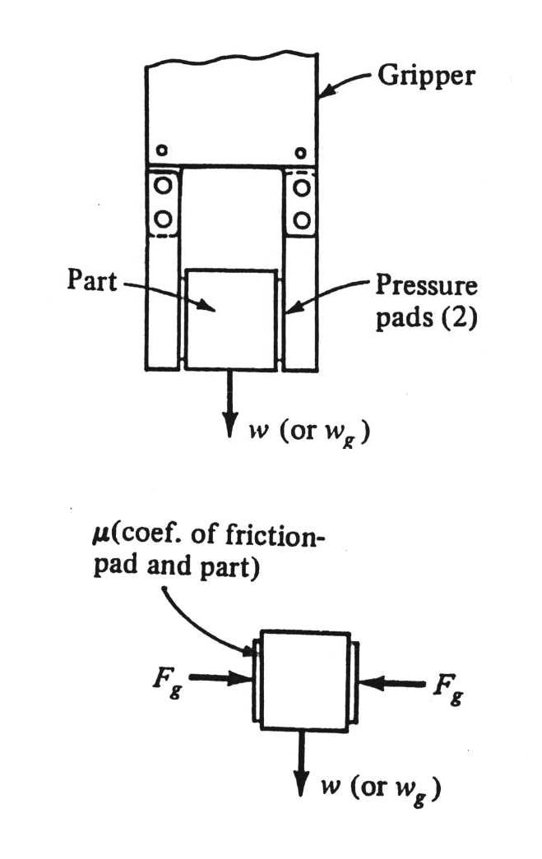
Gripping Force Equation
w = μ. n_{f} . F_{g} (1)
where: μ = coefficient of friction of the finger contact surface against the part surface
n_{f} = number of contacting fingers
Fg = gripper force
w = weight of the part or object
Note, in equation (1) one assumes:
1. The weight alone is the force tending to cause the part to slip out of the gripper
2. The force of gravity is directed parallel to the contacting surfaces
Forces on flat gripping
IMSE381

Slide 11
Gripping Force (continue)
Effect of acceleration and deceleration:
  In fast part handling cycles, the force of acceleration would be a significant factor and should be taken into consideration. Therefore,
w G= μ. n_{f} . F_{g} (2)
where G is a factor that takes into account the combined affect of gravity and acceleration.
If the acceleration force is applied in the same direction as the gravity force, then G= 3.0.
If the acceleration force is applied in the opposite direction as the gravity force, then G = 1.0.
If the acceleration is applied in a horizontal direction, then G = 2.0.
IMSE381
Notes:
IMSE 381
E. ORADY

Slide 12
Example 1
Suppose a stiff cardboard carton weighting 10 lb is held in a gripper using friction against two opposing fingers. The coefficient of friction between the finger contacting surfaces and the carton surface is 0.25. The orientation of the carton is such that the weight of the carton is directed parallel to finger surfaces. Calculate the required gripper force for the conditions given using G = 3.0.
w G= μ. n_{f} . F_{g} (2)
(10) (3) = (0.25) (2) Fg
Fg = 60 lb
μ Fg
Fg
W =10 lb
IMSE381

Slide 13
Factor of Safety
Note, in the example presented above, it is assumed that the robot grasps the carton in the center of mass, so that there are no moments that would tend to rotate the carton in the gripper. Therefore, in using Equation (2) as a design formula, a factor safety would typically be applied to provide a higher computed value of gripper force.
Factor of safety factor range is typically between 1.5 and 2.0.
Thus in example 1, If a factor of safety equals 1.5 is considered, then:
Fg = 1.5 * 60 = 90 lb.
would be the required gripper force.
IMSE381

Slide 14
Actual Effect of Acceleration and deceleration
It is possible to determine actual value of G factor without using the rule of thumb suggested above. In this case data must be available concerning the acceleration (deceleration) of the part and the direction of acceleration (deceleration).
G = 1 + a/ g (3)
where:
a = actual acceleration/deceleration
g = gravity acceleration
IMSE381

Slide 15
Example 2
Consider EXAMPLE 1 except assume that it is known that the carton will experience a maximum acceleration of 40 ft/sec/sec in a vertical direction when it is lifted by the gripper fingers. Also, assume the force of acceleration is applied in the same direction as weight and this direction is parallel to the contacting surfaces between the carton and the fingers.
G = 1+ a/g
G = 1 + 40/32.2 =2.24
Fg = (2.24x 10)/(0.25x2) = 44.8 lb
IMSE381

Slide 16
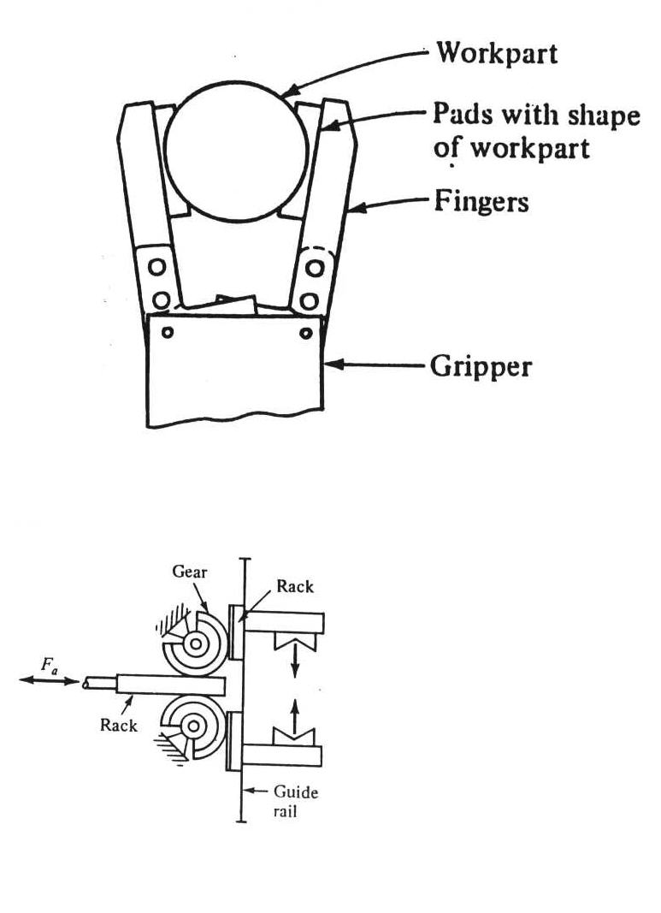
Types of Gripper Mechanisms
There are various ways for classifying mechanical grippers and their actuating mechanisms. One way is the type of finger movement used by the gripper.
1. Pivoting movement
  In pivoting movement the fingers rotate about fixed pivot points on the gripper to open and close.
2. Linear or translational movement
  In the linear movement, the fingers open and close by moving in parallel to each other.
pivot
Translational motion
IMSE381

Slide 17
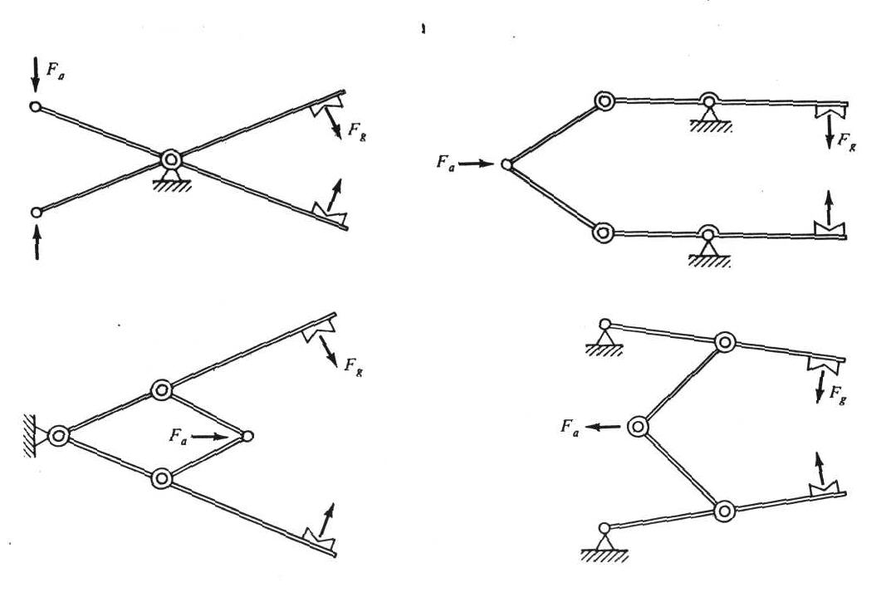
Mechanical Grippers Classes According to the Type of Kinematic Device Used to Actuate the Finger Movement
Linkage Actuation
IMSE381

Slide 18
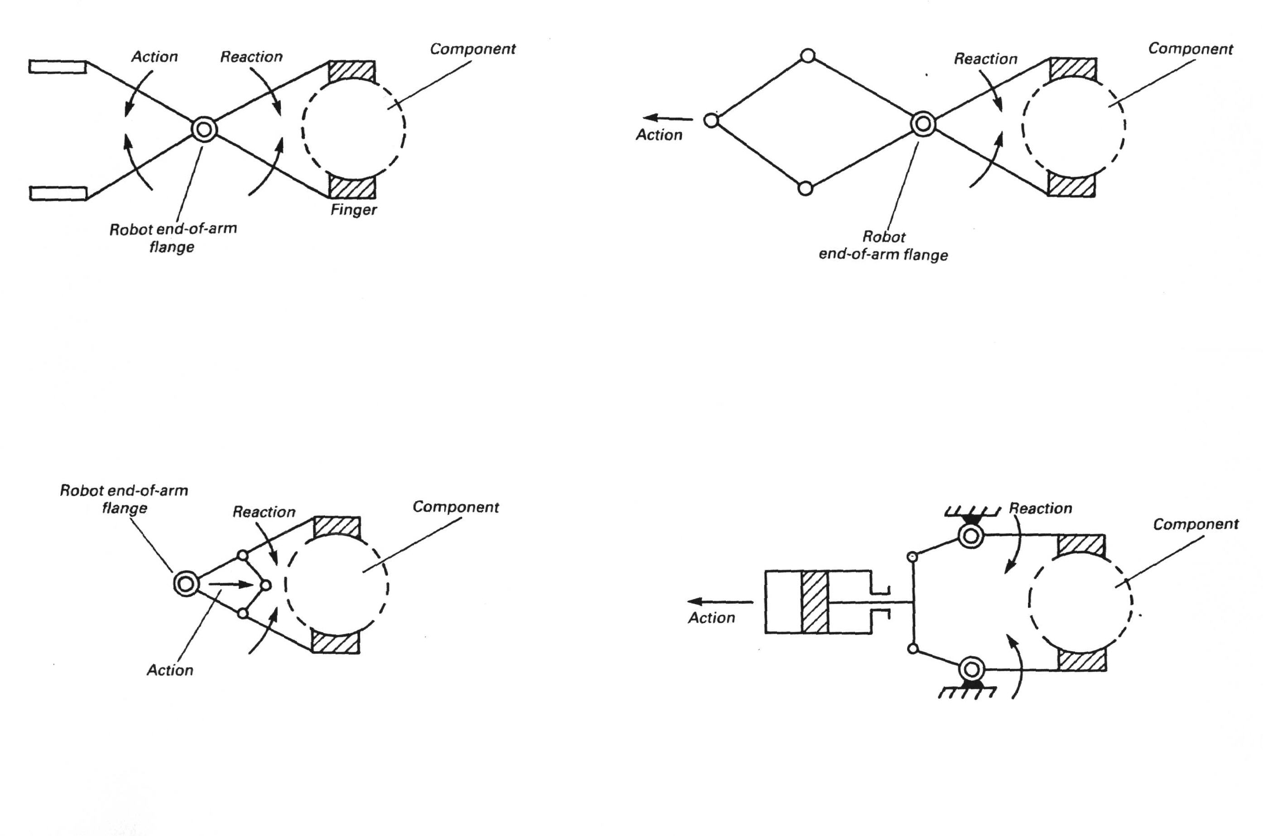
Linkage Actuation
http://www.youtube.com/watch?v=I4R0mav6twY
IMSE381

Slide 19
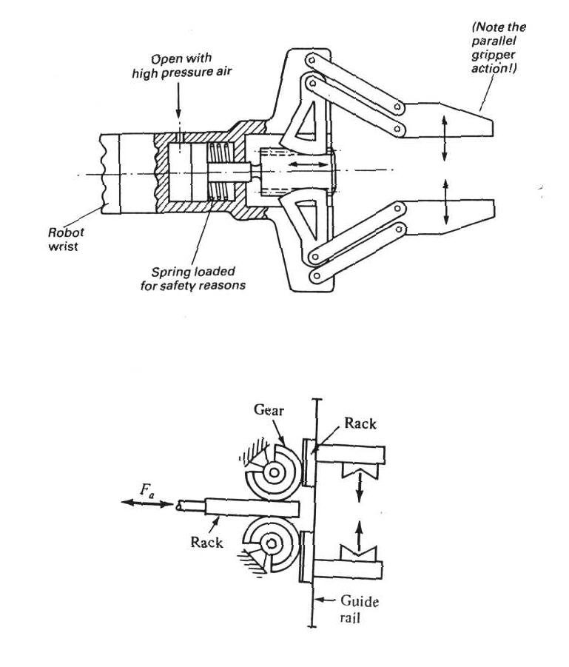
Gear - and - rack actuation
http://www.youtube.com/watch?v=ThLMGLLvAQ4
IMSE381

Slide 20
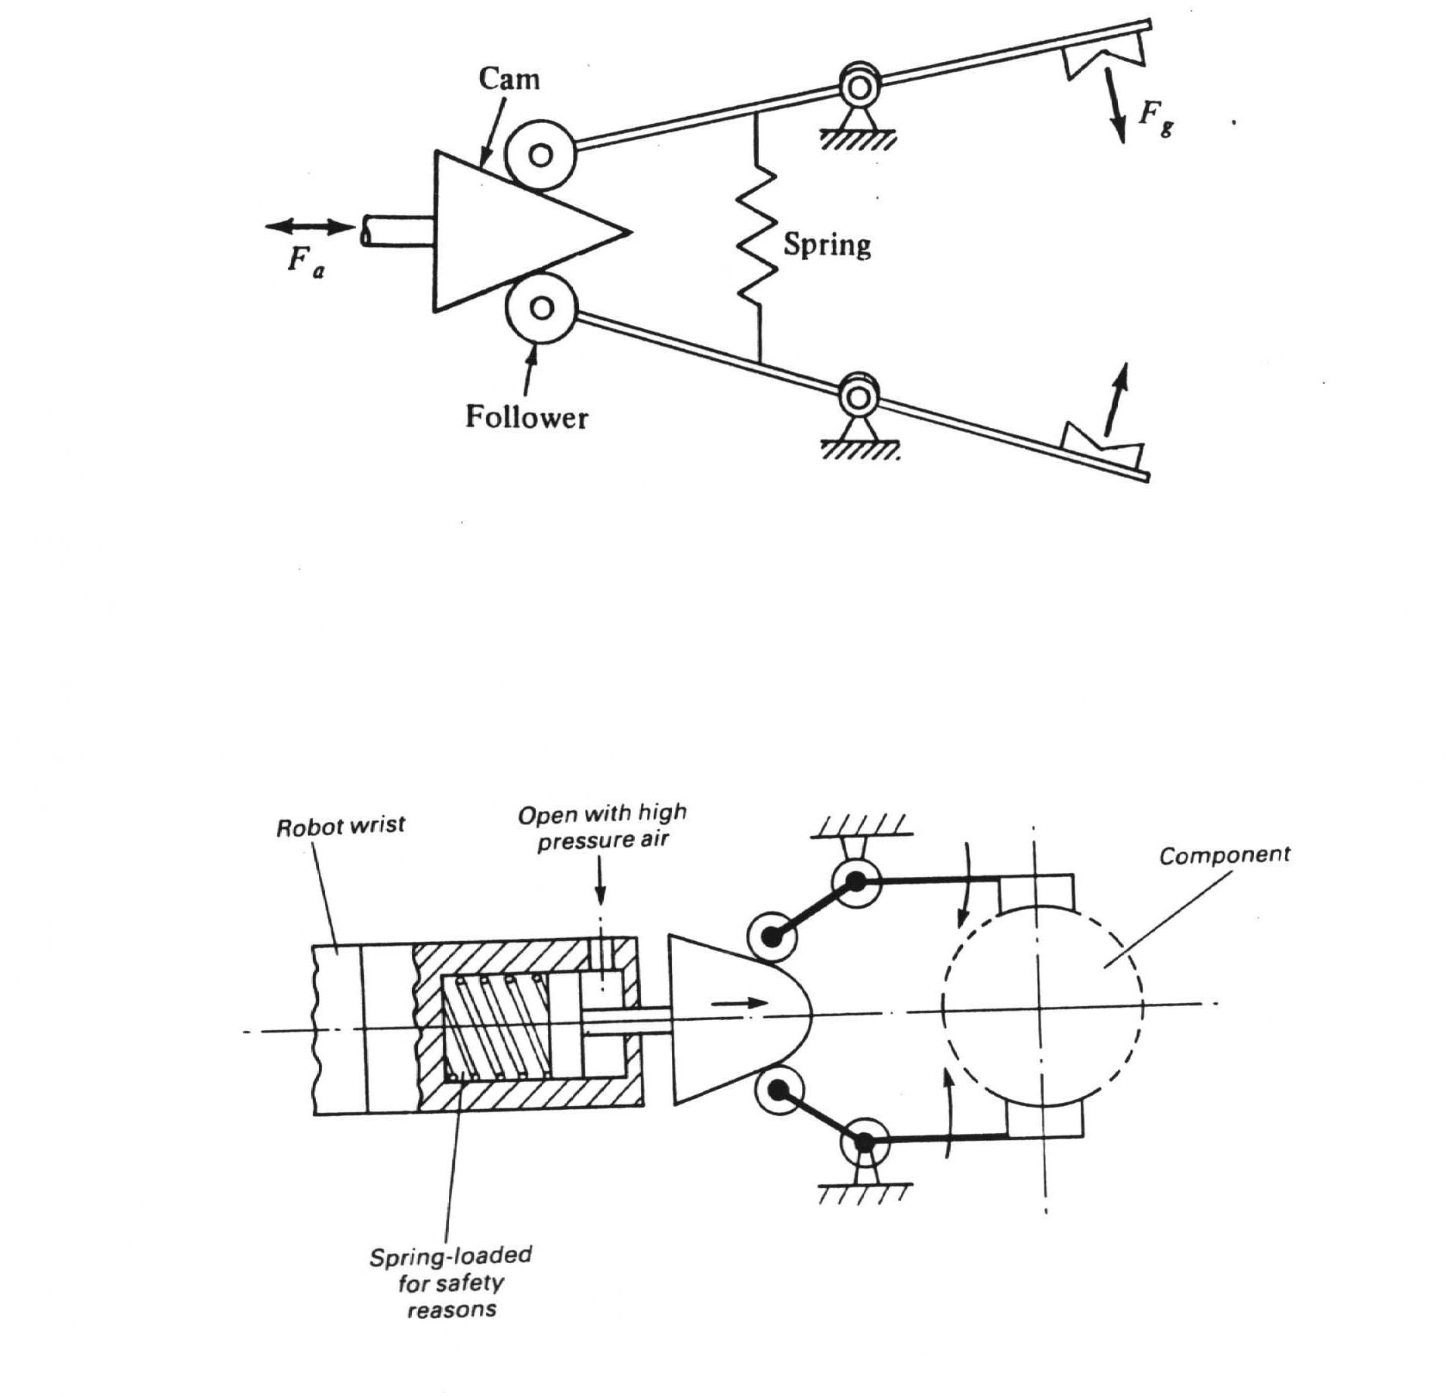
Cam actuation
IMSE381

Slide 21
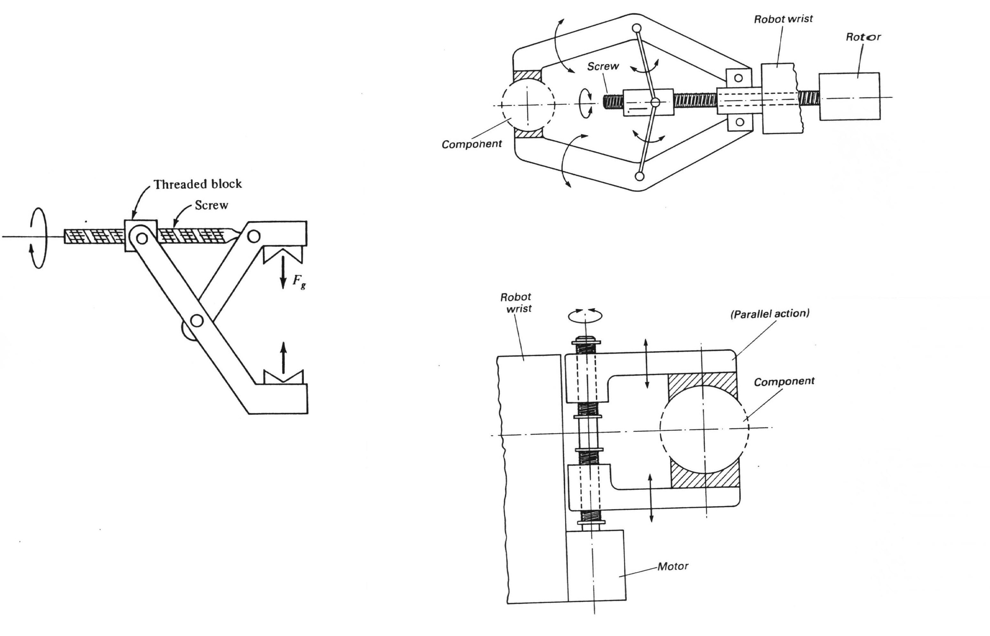
Screw actuation
http://www.youtube.com/watch?v=HMQ4u9UlPSQ
IMSE381

Slide 22
Gripper Force Analysis
The purpose of the gripper mechanism is to convert input power into the required motion and force to grasp and hold an object
The goal is to determine the magnitude of the required input power in order to obtain a given gripper force.
Assumption
A friction type grasping action is being used to hold the part, therefore we can use the gripper force calculated in (2) as our starting point.
IMSE381

Slide 23
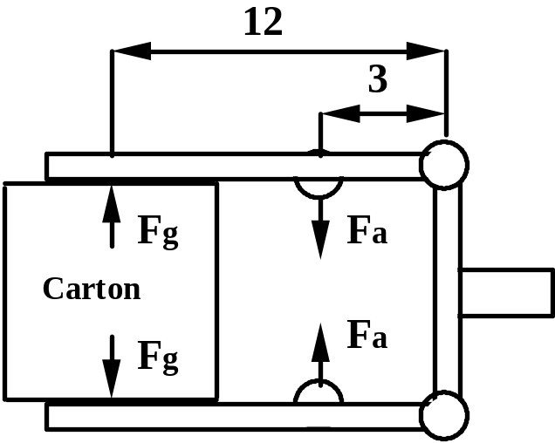
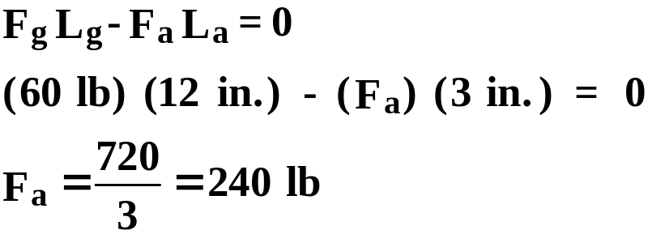
Example 3
Suppose the gripper is a pivot type device used for holding the cardboard carton. The gripper force calculated from previous example is 60 lb. The gripper is to be actuated by a piston device to apply an actuating force Fa.
Analysis require that the moment about pivot arms be summed and made equal to zero.
La
Lg
IMSE381

Slide 24
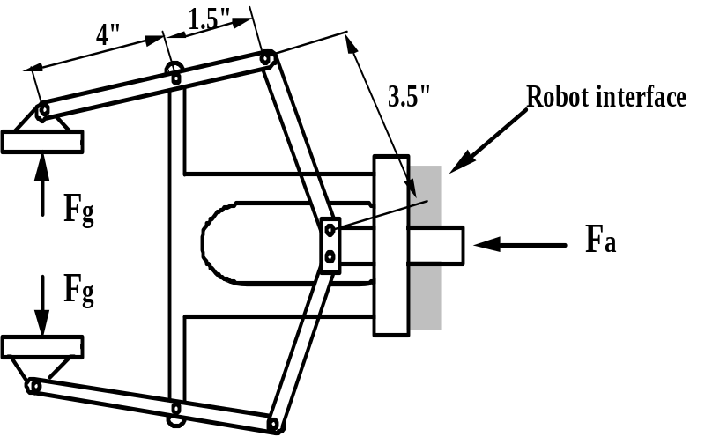
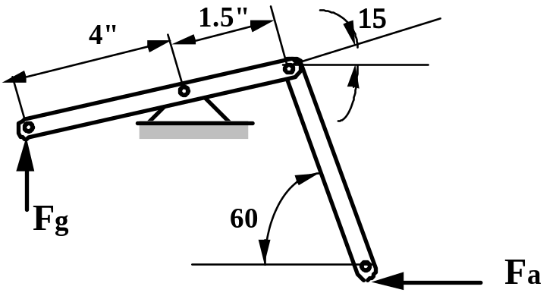
Example 4
The Figure presented below shows the linkage mechanism and dimensions of a gripper used to handle a work part for a machining operation. Suppose that it has been determined that the gripper force is to be 25 lb. Calculate the actuating force required to deliver this force of 25 lb.
Using the symmetry of the gripper only one -half of the mechanism needs to be considered.
IMSE381

Slide 25
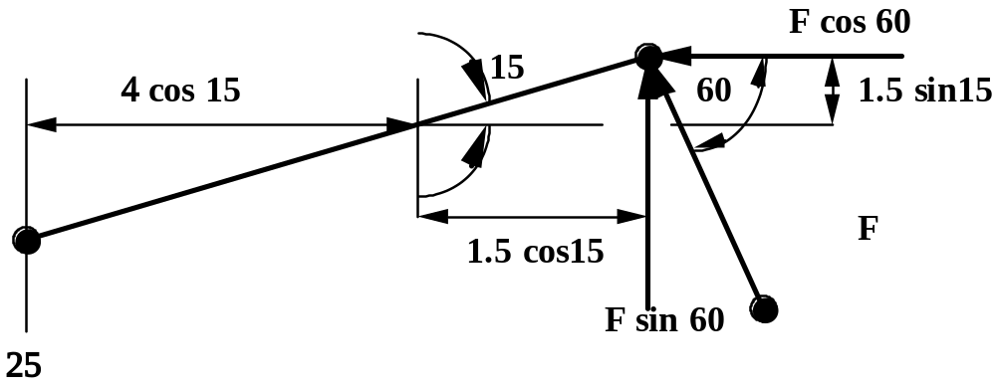
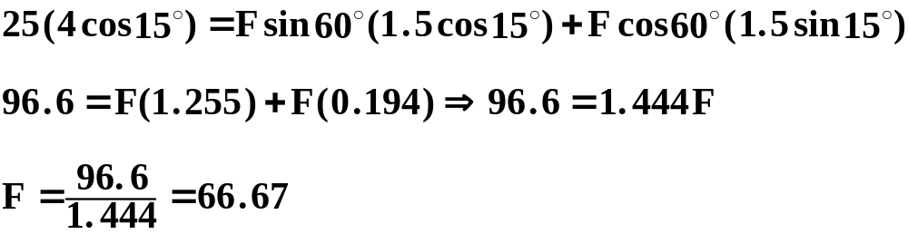
Example 4 (continue)
Lb.
IMSE381

Slide 26
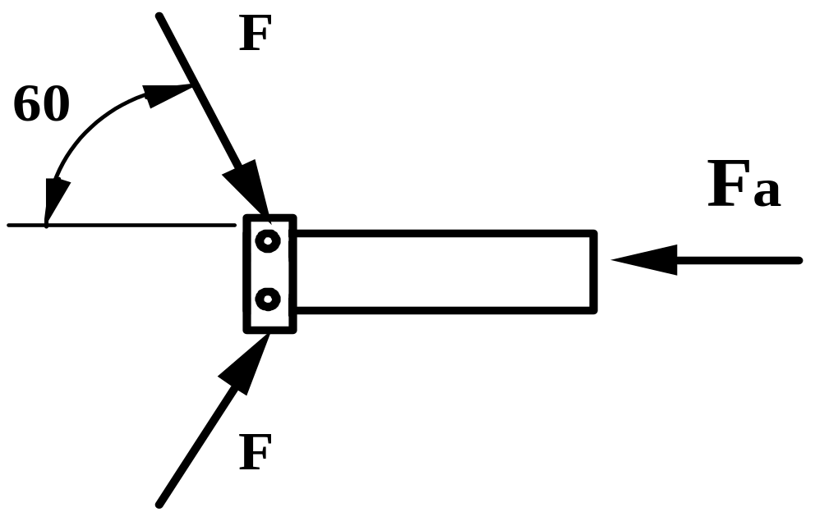
Example 4 (continue)
By analyzing the applied forces
F_{a} = 2 F cos 60º
F_{a} = 2 x 66.67 x 0.5 = 66.67 lb.
IMSE381

Slide 27
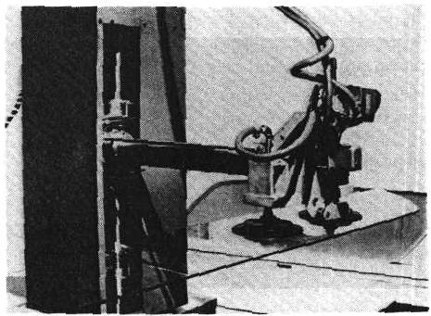
Vacuum Cup Grippers
Can be used as long as vibration shock when object jumps to the gripper is not a problem.
The usual requirements on the object to be handled are that they be flat, smooth, and clean, conditions necessary to form a satisfactory vacuum between the object and the cup.
Vacuum cups work using Pneumatic vacuum system.
Vacuum cups gripper lifting a mass
Source: Groover
Vacuum cups
IMSE381

Slide 28
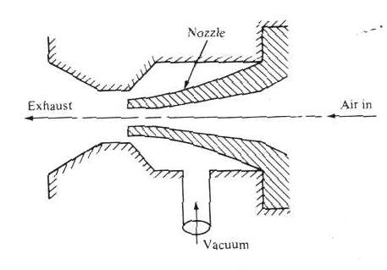
Operation of Vacuum Cups
http://www.youtube.com/watch?v=yTKmfRcpQes
Vacuum cups operate by using a vacuum pump or a device as the one shown in the figure.
Lifting capacity of the cup (F)
F = P A (4)
where: P = the negative pressure
A = the total effective area of the suction cup(s)
Negative pressure (P)
Vacuum cup device used to operate suction cups
Source: Groover
IMSE381

Slide 29
Example 5
A vacuum pump to be used in a robot vacuum gripper application is capable of drawing a negative pressure of 5.0 lb/in.² compared to atmospheric pressure. The gripper is to be used for lifting stainless steel plates, each plate having dimensions of 15 by 35 in. and weighing 60 lb. Determine the diameter of the suction cups to be used for the robot gripper if it has been decided that three (3) suction cups will be used for the gripper greater stability. A factor of safety of 1.5 should be used in the design computation.
Solution)
P = 5 psi F =60 lb n=3 SF = 1.5
Determine A= cup area and D diameter ???
F. SF = P .n.A
A = F.SF/(n. P) = 60 x 1.5/(3 x5) = 6.00 in.²
= pD²/4 =6 in.2 ➔D² =4x6/p =7.64 ➔ D = 2.764 in
IMSE381

Slide 30
Advantages and disadvantages
Advantages
Requires only one surface of the part for grasping.
Applies a uniform pressure distribution on the surface of the part.
Relatively light - weight gripper.
Applicable to a variety of different materials.
Disadvantages
Can not handle porous or perforated parts (the parts with holes)
http://www.youtube.com/watch?v=I-R6FF4RMHA
IMSE381

Slide 31
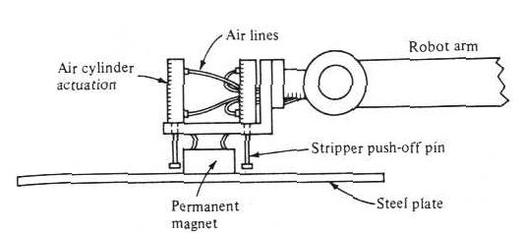
Magnetic grippers
Permanent Magnet Gripper with stripper device
Can be used as long as the objects being held are metallic and not destroyed by magnetic fields. It is used for handling ferrous materials except some kinds of stainless steel.
Types
  Permanent magnets; no external power supply needed, more applicable for handling tasks in hazardous environment requiring explosive proof apparatus.
2. Electromagnetic gripper
Uses a dc power source and
controller to regulate picking
and releasing the part.
http://www.youtube.com/watch?v=7vM_2WyWRb4
IMSE381

Slide 32
Advantages and Disadvantages
Advantages
Pickup times are fast.
Variation in part size can be tolerated. The gripper does not have to be designed for one particular work part.
They have ability to handle metal parts with holes.
They require only one surface for gripping.
Disadvantages
The residual magnetism remaining in the workpiece may cause problem in subsequent handling.
Possible side slippage and other errors limit the precision of this type of handling.
Can pick up more than one object from the stack.
IMSE381

Slide 33
Adhesive grippers
Holding is done by using sticky tape and another adhesive. Used to handle fabrics and other light weight materials.
The requirements on the object to be handled are that they must be gripped on one side only.
Disadvantages
The adhesive substance loses its tackiness on repeated usage.
The reliability of a gripping device diminishes with each successive operation cycle.
IMSE381

Slide 34
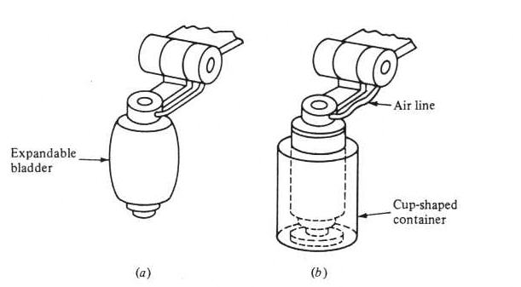
Other types of grippers
http://www.youtube.com/watch?v=DW4ttbLh_kA
Hooks used to load unload parts hanging from conveyors
Scoops and ladles can be used to handle liquids or powders
Inflatable bladders used to handle fragile materials such as glass containers.
Inflatable bladder used to grasp
of cup-shaped container
Source: Groover
IMSE381

Slide 35
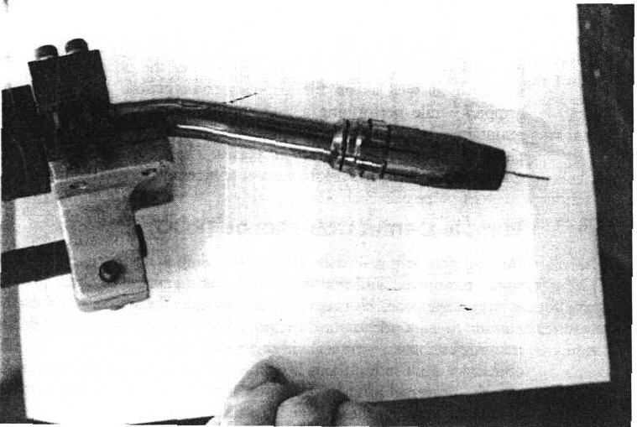
Tools as End Effectors
Tool is attached directly to the robot wrist
Examples
  Spot welding tools
  Arc-welding guns (see figure)
  Spray painting nozzle
  Rotary spindle for operations such as drilling, grinding, wire brushing, etc.
  Water jet cutting
  http://www.youtube.com/watch?v=EMvvB-_V0Eo
Arc welding gun used as end effector
of the AR-1 welding robot
Source: J. L. Fuller
IMSE381

Slide 36
Compliance
Drilling precisely drilled holes or assembling small parts requires tight positional tolerances
Making manipulators capable of such tolerances is very expensive
Using vision sensors and achieving vision-motion coordination is even more challenging
Compliance techniques solve the slight misalignment problems in more economic ways
Compliance means initiated or allowed part movement for the purpose of alignment between mating parts
Two categories
  Passive compliance
  Active compliance
IMSE381

Slide 37
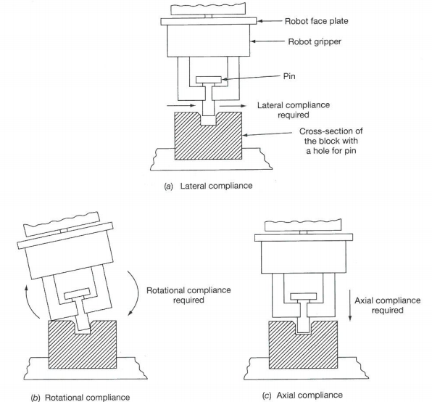

Types of Required Compliance
Source: Rehg
IMSE381

Slide 38
Passive Compliance Using Remote Center Compliance (RCC)
Components and functions of RCC Device
  Shear pads
    made from alternate layers of elastomer and metal shims
    stiff in the axial directions but highly compliant in the lateral and rotational directions
    The slight angle of the shear pad causes the rotational compliant effect as illustrated in the figure
  Shear pins
    for protection against excessive movement
  Lockup
    Removes the compliance from the RCC device by locking the top and bottom plates through rigid pins
    Makes the device rigid for moves or for operations where compliance is not desired e.g. to prevent oscillations after a quick move to the assembly
IMSE381

Slide 39
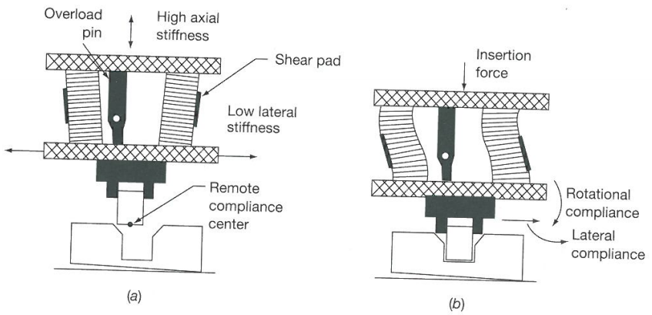
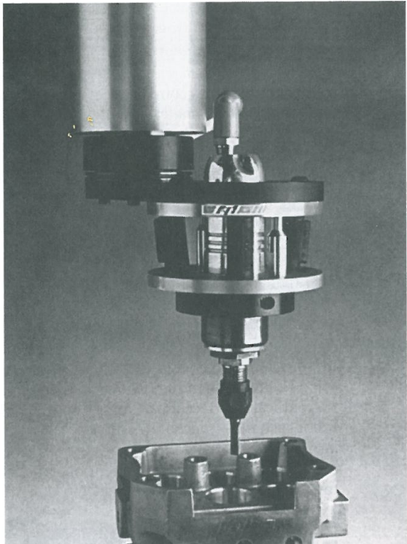
Remote Center Compliance (RCC) Operations
For Assembling
For Deburring
Source: Rehg
IMSE381

Slide 40
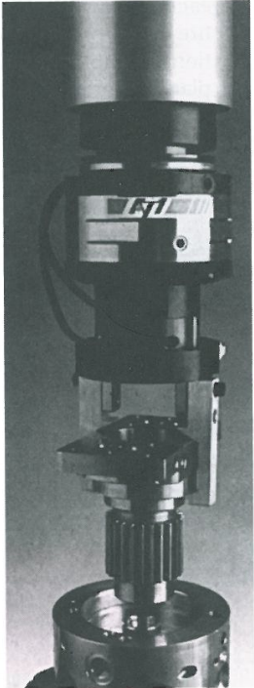
Active Compliance
Active compliance systems measure the force and torque (F/T) present when robot performs the programmed task
F/T sensing allows the robot to detect changes and variations in the workpiece or tooling and adapt the program to correct them
Robot moves are based on a required or measured force instead of a programmed point
F/T sensing uses an adaptor placed between the gripper and the robot tool plate (see Fig)
Example: Strategies for Gear Assembly Application
  Move until the specified force threshold is exceeded
  Move in a defined spiral search pattern to find a hole
  Move to verify assembly
  Move to cause a snap-fit assembly
Source: Rehg
IMSE381

Slide 41
Multiple End-Effector Systems
As work cells become more complex and robots more sophisticated, the application of multiple gripper systems increases
Two techniques for implementation of multiple gripper systems
  Mount physically two or more tools to a single tool plate
  Use tool changing technology to swap end-effectors, requiring a standard interface at the robot wrist
IMSE381

Slide 42
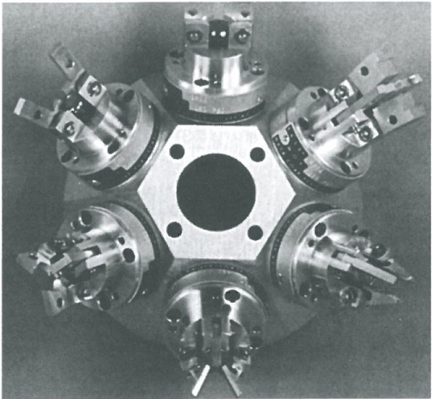
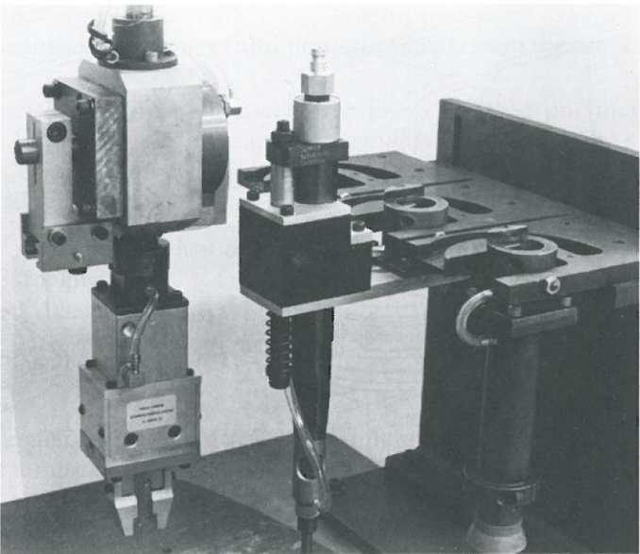
Multiple End-Effector Systems
Multiple tools on a single plate
Tool Changing System
Source: Rehg
IMSE381

Slide 43
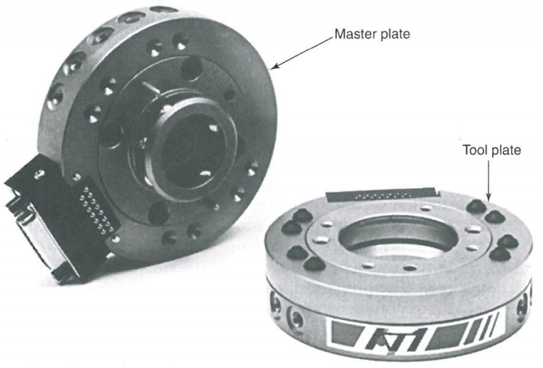
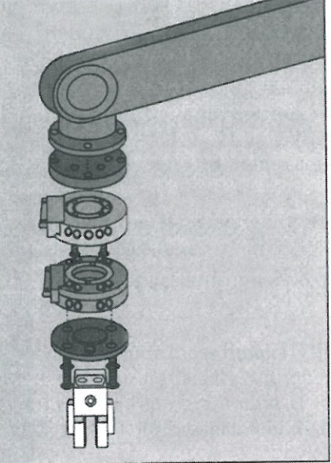
Wrist Interface for Tool Change
The robot must be able to change tooling under program control
The wrist interface must satisfy the following interface requirements
  Mechanical interface - Electrical interface
  Pneumatic interface - Replaceable or quick-change capability
Quick- Change System
IMSE381
Source: Rehg

Slide 44
Advantages and Disadvantages of Multiple-Gripper Systems
Advantages
  Increase the production capability of the work cell
  Reduce work-in-process time for the part because it requires fewer workstations
  Use the robot arm and controls more efficiently
  Many assembly applications would not be possible without the multi-gripper workcells
Disadvantages
  Add more complexity to the tool design problem
  Results in greater cost for the devices
IMSE381

Slide 45
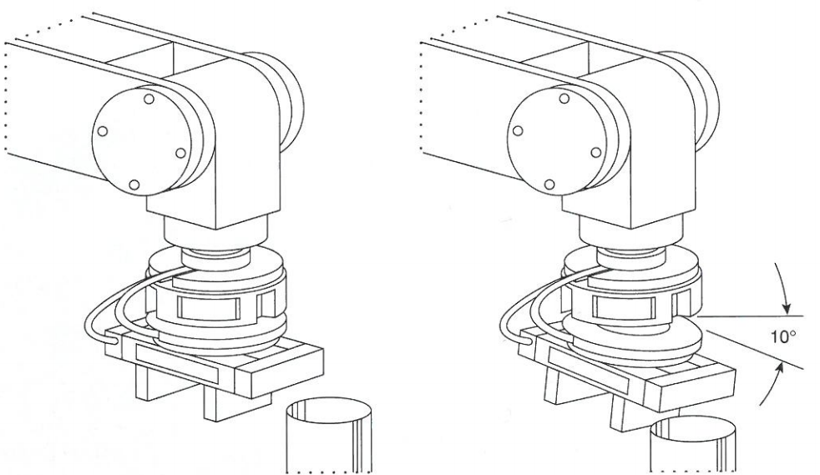
Collision Protection Systems
Purpose: to protect expensive tooling from a damaging collision with other work-cell hardware
Collision protection devices are placed between the tooling and the robot tool plate
In collision situation, they are designed to give in. The difference in motion between the tool plate and tooling creates forces on the collision coupling
If these forces exceed a limit, the collision device initiates an emergency stop signal to robot
Collision Protection Coupling
Source: Rehg
IMSE381

